Slide 1
Underwater Image Enhancement Using the Multilayer Perceptron and Color Feature-Based SRCNN
By :
Vaibhav rathod
20MCS020
IIITDM Jabalpur
AI presentation

Slide 2
ABSTRACT
Problems in Traditional Approach : The traditional underwater visual display systems have problems, such as low visibility, poor real-time performance, and low resolution, and cannot meet the needs of real-time high dentition displays in extreme environments.
Solution : An underwater image enhancement method and a corresponding image super-resolution algorithm.
Image enhancement Technique.
Super-resolution Convolutional neural networks
the Retinex algorithm
gamma correction.
Dark prior

Slide 3
SRCNN MODEL
The SRCNN network structure is constructed by a three-layer convolutional neural network, which is composed of image block feature extraction and representation, and also nonlinear mapping and reconstruction of high-resolution images.
First layer, feature extraction and representation is applied to the image blocks from the original image, and the image blocks extracted by convolution can be expressed as
F1(Y )= max(0 , W1*Y + B1) ----(1)
where Y represents the original high-resolution image ,W1 and B1 represent the convolution kernel and deviation.
Second layer of nonlinear mapping is as follows:
F2(Y)= max(0 , W2*F1(Y) + B2) --------(2)
Third layer, a convolution is conducted on the output high resolution image blocks of the second layer to generate images that are close to the original high-resolution images, which can be expressed as:
F3(Y)= max(0 , W3*F2(Y) + B3) --------(3)

Slide 4
PROPOSED METHOD
MULTILAYER PERCEPTRON-BASED ENHANCEMENT
First, Retinex algorithm is used to initially defog the image. Second, due to the low contrast of underwater images, the image brightness was adjusted by gamma correction to make the image more natural.
The preprocessed image can be obtained from the following equation:
r’ (x, y) =r’’(x, y)
where r’(x, y) is the image enhanced with the Retinex algorithm and r’’(x, y) is the Gamma corrected map.
Finally, a dark channel prior is used, and the contrast stretch technique is applied to improve the dynamic range of the image.

Slide 5
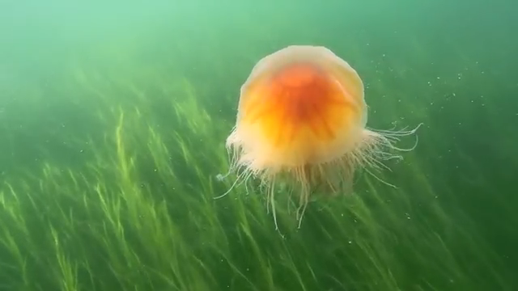
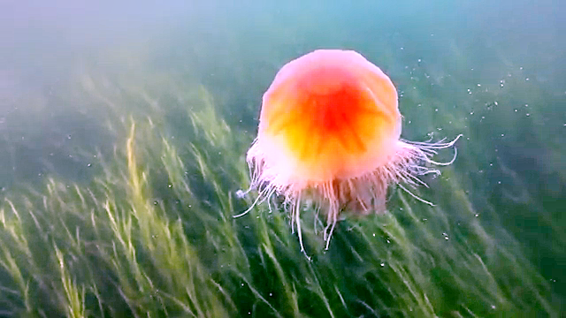
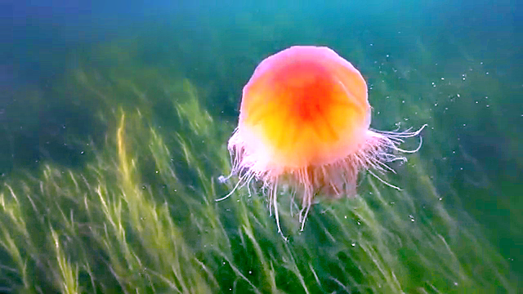
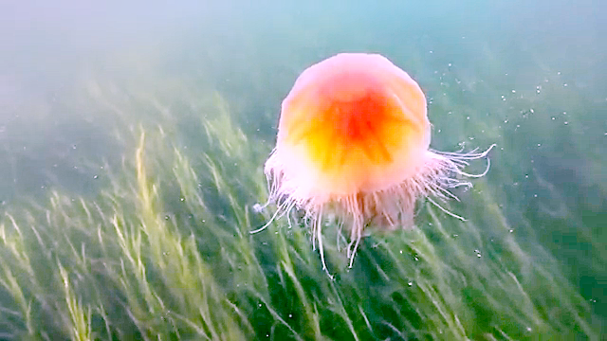
Output of MULTILAYER PERCEPTRON-BASED ENHANCEMENT
Original Image
After Retinex
After Dark Prior
After Gamma Correction

Slide 6
COLOR FEATURE-BASED SUPERRESOLUTION
The method in this paper is based on an SRCNN composed of three convolution layers to improve the input image. The method in this paper is divided into three steps.
The first step is to divide the low-resolution image into three separate images with three RGB channels.
In the second step, the three images are trained by a convolutional neural network to obtain three output images. In the
Third step, the obtained three images are fused to obtain the high-resolution image reconstruction.
The first step is channel processing. The original image is divided into R, G and B channels to extract different information from each channel. The segmentation processing formula can be expressed as:
Fi =image(Fi) (i = R,G, B)

Slide 7
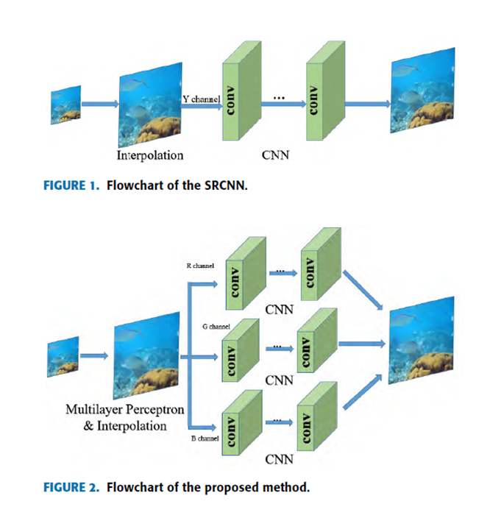
The second step is the convolutional neural network training. The images of the three different channels are trained by a convolutional neural network. The training formula can be expressed as:
Fi = max(0,Wj * Fi(j-1) + Bj) (j = 1, 2, 3)
The third step is image fusion, where the output image of the second step is fused. The fusion formula can be expressed as:
F = Image(Fr , Fg , Fb)
Dataset used : UIEB Dataset Size (630 MB) 890 raw underwater images with corresponding high-quality reference images
SRCNN Training
Training SRCNN 100 Epochs
Adam Optimizer (0.001 learning rate)
Testing on 60 challenging underwater images.

Slide 8

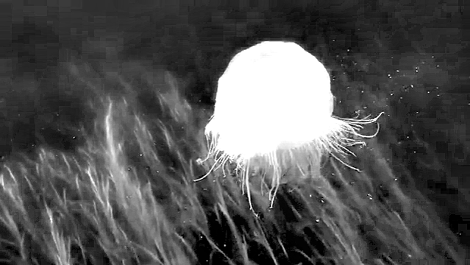
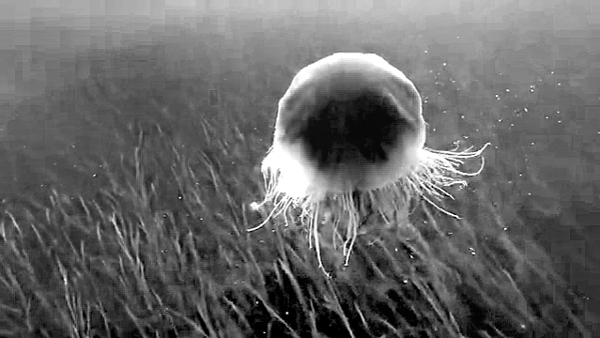
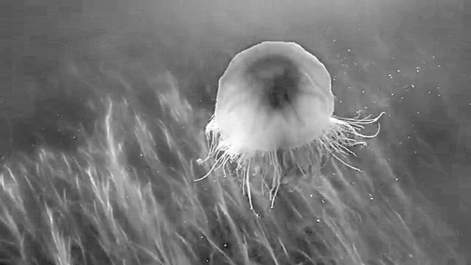
EXPERIMENTAL RESULTS AND DISCUSSION
VISUAL ANALYSIS
Original image
Retinex image
Gamma Image
SRCNN Images
Red channel
Blue channel
Green channel
Dark Prior

Slide 9
Red Channel
Blue Channel
Green Channel
Fused Image/Output Image

Slide 10
IMAGE QUALITY EVALUATION
PSNR : peak signal-to-noise ratio, ii between two images.
This ratio is used as a quality measurement between the original and a compressed image.
Image Channels | PSNR value
Red channel | 29.4263
Green channel | 28.6954
Blue channel | 31.6093
Images no. | PSNR value | SSIM Value | PSNR/SSIM
image1 | 15.135387224955284 | 0.5460245819947694 | 27.719241448181304

Slide 11
Conclusion
This paper presented an improved image enhancement method and an image super resolution method. The proposed enhancement method employed a combination of the Retinex algorithm and a neural network to enhance the details of the image and restore the image color.
Referring to the network structure of an SRCNN, a convolutional neural network model that is trained on the R, G and B channels of an image is adopted, and the output images are fused to obtain clear textures and edge effects under the premise of ensuring the PSNR indexes.
a good reconstruction effect on most images, its advantages are not obvious for images with nonobvious edges and irregular textures.
The next step is to try to classify and reconstruct the edges and textures to generate images with clear edges and rich textures and further study image fusion.
I will further try the SRGAN Model to reconstruct the edges and textures to generate images with clear edges and rich textures

